Slide 1
Java
Spring Web MVC

Slide 2

Module Objectives
After completing this course you will be able to:
Understand Spring Web MVC's architecture
Implement a Web MVC solution
Configure Web MVC
Make use of controllers
Use Spring Forms

Slide 3
MVC Recap
Spring MVC Introduction
Implementation
3

Slide 4
Spring MVC
Model Contains business logic and custom objects
View Generates output representations for the user
Controller
Sends commands to the model and the view and passes objects around where required
View
Controller
Model

Slide 5
MVC Recap
Spring MVC Introduction
Implementation
5

Slide 6
What is Spring MVC?
Spring’s web framework
Implements the Front Controller pattern (Java EE pattern)
All requests are addressed to a central servlet
The servlet delegates requests to controller classes
Controllers do the request handling work
In Spring, this “central servlet” is known as the DispatcherServlet
Facilitates working with Servlets and JSP
No need to create a Servlet for each command

Slide 7
Why use Spring MVC?
Encourages use of best practices and SOLID
Separation of concerns
Each role (controller, validator, servlet, view, model objects, etc.) can be fulfilled by a specialized object.
Simplification
Easy to configure.
Far fewer servlet mappings.
Form binding
Allows us to bind an object to a Spring form directly.
Spring populates the object with form data automatically, instead of having to retrieve form parameters one by one.

Slide 8
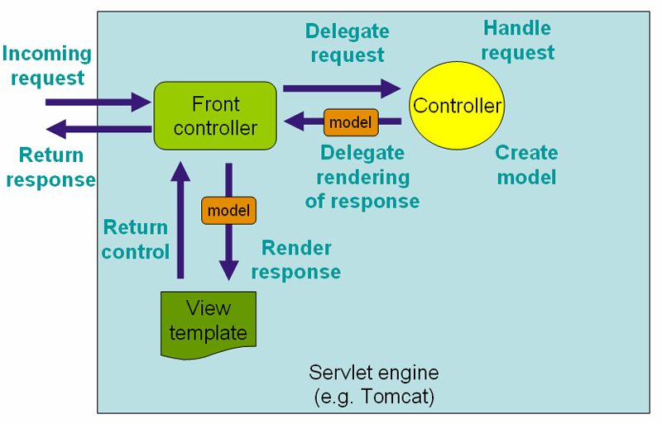
Spring MVC Architecture
http://static.springsource.org/spring/docs/current/spring-framework-reference/html/mvc.html (Accessed 05/11/2014)
Notes:
Front controller = DispatcherServlet – Map in web.xml
Controller = Controller classes, defined either in the dispatcher-servlet.xml or by annotation in the classes
View = JSTLView and Internal View resolver
Model = normal POJO’s and standard logic

Slide 9
MVC Recap
Spring MVC Introduction
Implementation
9

Slide 10
Initializer and DispatcherServlet
DispatcherServlet is a Spring-provided class that extends HttpServlet.
public class Initializer implements WebApplicationInitializer {
@Override
public void onStartup(ServletContext sc) throws ServletException {
AnnotationConfigWebApplicationContext context = new AnnotationConfigWebApplicationContext();
context.register(Config.class);
context.setServletContext(sc);
sc.addListener(new ContextLoaderListener(context));
ServletRegistration.Dynamic appServlet = sc.addServlet("dispatcher", new DispatcherServlet(context));
appServlet.setLoadOnStartup(1);
appServlet.addMapping("/");
}
}
Notes:
The / in URL pattern tells the servlet to handle all requests.
This could be set to *.jsp to handle JSP requests only, or *.html for HTML requests only.
/* would work for all pages but this would cause problems with requests for static content such as images.

Slide 11
Spring Configuration
First, specify the base package.
This will activate Spring Web MVC annotation scanning and will look for annotated classes in the given package.
@Configuration
@EnableWebMvc
@ComponentScan(basePackages = "com.fdmgroup")
public class Config {
}

Slide 12
View Resolver Bean
In order to obtain the view to send to the client, Spring consults a view resolver.
logical view name
It attaches a specified prefix and suffix to a logical view name.
/WEB-INF/views/home.jsp
prefix
suffix
@Bean
public ViewResolver viewResolver() {
InternalResourceViewResolver resolver = new InternalResourceViewResolver("/WEB-INF/views/", ".jsp");
resolver.setViewClass(JstlView.class);
return resolver;
}

Slide 13
Entity Manager Factory Bean
For a LocalEntityManagerFactoryBean, configuration settings are usually read in from a META-INF/persistence.xml residing in the class path, according to the general JPA configuration contract.
LocalContainerEntityManagerFactoryBean however is more
you can override the location of the persistence.xml file
specify the JDBC DataSources to link to,etc.
@Bean
public LocalContainerEntityManagerFactoryBean entityManagerFactory() {
LocalContainerEntityManagerFactoryBean entityManagerFactory = new LocalContainerEntityManagerFactoryBean();
entityManagerFactory.setPersistenceUnitName(“XXXXXXX”);
entityManagerFactory.setDataSource(dataSource());
entityManagerFactory.setJpaVendorAdapter(new HibernateJpaVendorAdapter());
entityManagerFactory.setJpaDialect(new HibernateJpaDialect());
entityManagerFactory.setPackagesToScan("com.fdmgroup");
entityManagerFactory.setJpaPropertyMap(hibernateJpaProperties());
return entityManagerFactory;
}

Slide 14
EMF Data Source
DataSource is a factory for connections to the physical data source specified by a DataSource Object
Basic implementation – (BasicDataSource) produces a standard Connection object
public DataSource dataSource() {
// org.apache.commons.dbcp.BasicDataSource
BasicDataSource basicDataSource = new BasicDataSource();
basicDataSource.setDriverClassName("oracle.jdbc.driver.OracleDriver");
basicDataSource.setUrl("jdbc:oracle:thin:@localhost:1521:xe");
basicDataSource.setUsername("trainee1");
basicDataSource.setPassword("!QAZSE4");
return basicDataSource;
}

Slide 15
Hibernate JPA Properties
private Map<String, ?> hibernateJpaProperties() {
HashMap<String, String> properties = new HashMap<>();
properties.put("hibernate.archive.autodetection", "class, hbm");
properties.put("hibernate.show_sql", "true");
properties.put("hibernate.format_sql", "true");
properties.put("hibernate.use_sql_comments", "true");
properties.put("hibernate.hbm2ddl.import_files", "insert-data.sql");
properties.put("hibernate.ejb.naming_strategy", "org.hibernate.cfg.ImprovedNamingStrategy");
properties.put("hibernate.hbm2ddl.auto", "update"); // create, create-drop, validate, update
properties.put("hibernate.c3p0.min_size", "2");
properties.put("hibernate.c3p0.max_size", "5");
properties.put("hibernate.c3p0.timeout", "300"); // 5mins
properties.put("hibernate.c3p0.max_statements", "50");
properties.put("hibernate.c3p0.idle_test_period", "3000");
return properties;
}

Slide 16
Controllers
DispatcherServlet delegates request handling to regular Java classes:
@Controller marks these classes
@RequestMapping maps a URL to a method
value: specifies mapped URL
method: specifies HTTP method
Methods return a String (logical name of the view to respond with)
@Controller public class HomeController { @RequestMapping(value="/register", method=RequestMethod.POST) public String goToRegisterPage(){ return "registration"; } }
@RequestMapping(“/register”) can also be used, if we wish to specify only the URL.

Slide 17
Controllers
For example, clicking on this hyperlink:
<a href="register">Register</a>
…executes the method below. Because it returns “registration”, you will be directed to: /WEB-INF/views/registration.jsp
@Controller public class HomeController { @RequestMapping("/register") public String goToRegisterPage(){ return "registration"; } }

Slide 18
Controllers
Methods annotated with @RequestMapping can take any number or type of parameters, as needed. For example:
An HttpServletRequest to access request data
Strings representing specific request parameters
A model object such as a User
Various others
@Controller public class HomeController { @RequestMapping("/register") public String goToRegisterPage(HttpServletRequest req){
String type = req.getParameter("userType");
log("Redirecting to registration page for "+type); return type+"registration"; }

Slide 19
Question
How do we usually access a variable that has been submitted through a form?

Slide 20
@RequestParam
Usually we get form parameters from the HttpServletRequest object: req.getParameter("paramName");
Spring provides an alternate way using @RequestParam:
@Controller public class HomeController { @RequestMapping("/register") public String goToRegisterPage(@RequestParam String username){ return "register/" + username; } }
Spring will get the form parameter “username”, and pass its value into the method parameter “username”.

Slide 21
@RequestParam
We can use @RequestParam, even on a method parameter with a different name, by using the value attribute:
@Controller public class HomeController { @RequestMapping("/register") public String goToRegisterPage(@RequestParam(value="username") String doesntMatch){ return "register/" + doesntMatch; } }
Spring will get the form parameter “username”, and pass its value into the method parameter “doesntMatch”.

Slide 22
@PathVariable
Binds a variable in the URL (a placeholder in the request mapping) to a method parameter
User-submitted data (such as a search term) can be displayed on the URL
@Controller public class LibraryController { @RequestMapping("/find/{title}") public String getBook(@PathVariable String title){ ... } }

Slide 23
Attributes
Spring facilitates how we pass around application data with the Model object:
@Controller public class LibraryController { @RequestMapping("/register") public String goToRegisterPage(Model model){ model.addAttribute("attributeName", new User()); return "register"; } }
This will become an attribute in the request scope, accessible by ${attributeName} or ${requestScope.attributeName}

Slide 24
Spring Forms
Spring Forms is a feature that allows us to bind an object directly to a form on a view.
Normally, we would manually retrieve each piece of user data from a request:
<form action="register" method="POST"> Username: <input type="text" name="username" /> Password: <input type="password" name="password" /> <input type="submit" value="Click Here" /> </form>
req.getParameter("username");
req.getParameter("password");

Slide 25
Spring Forms
Spring’s custom tags allow us to create a form bound to a particular object in the Model:
sf is the tag library prefix, but we can use any prefix.
modelAttribute specifies the name of the Model attribute that holds the object this form will be bound to.
path specifies the property of the object to which a particular input is bound.
<sf:form action="process" method="POST" modelAttribute="user"> <sf:label path="username"> Username </sf:label> <sf:input type="text" path="username" /> <sf:label path="password"> Password </sf:label> <sf:input type="password" path="password" /> <input type="submit" value="Click Here" /> </sf:form>

Slide 26
Spring Form on a JSP
To use Spring Form custom tags on a JSP (e.g. registration.jsp), these taglib directives are required:
Additionally, the JSP must be passed the modelAttribute object (to which to bind the form) when it is first loaded!
<%@ taglib prefix="s" uri="http://www.springframework.org/tags" %>
<%@ taglib prefix="sf" uri="http://www.springframework.org/tags/form" %>
@RequestMapping("/register") public String goToRegisterPage(Model model){ model.addAttribute(“user”, new User()); return "registration"; }
Done before loading registration.jsp!

Slide 27
Using the Populated Object
To retrieve the data, simply add a parameter of the object’s type to the destination controller method:
This User object is populated with the data from the form!
Previously, we would have had to populate this object manually, with individual parameter values.
@RequestMapping(value="/process", method=RequestMethod.POST)
public String register(User user){ log(user.getUsername()+" has registered!"); return "confirmation"; }

Slide 28
Summary
1. We click on the “register” link and the request goes to the front controller (DispatcherServlet)
2. The servlet delegates the request to our controller method mapped to “register”
3. The controller creates a User (to be bound to the registration form later) and sends it back to DispatcherServlet
4. DispatcherServlet uses the view resolver to render a response, binding the model object (the User) to it

Slide 29
Module review
How does Spring retrieve the correct view to use?
What processes user requests?
Where do all requests initially go?
How do you pass attributes back to the users browser?
Describe the route taken between an initial request and the final response.

Slide 30
Questions

Slide 31
Review
You are now able to:
Understand Spring Web MVC's architecture
Implement a Web MVC solution
Configure Web MVC
Make use of controllers
Use Spring Forms
31

